Slide 1

Diabetes Predictive modelling
Predicting diabetes using classification techniques in machine learning.
by: Rishabh Gupta
(14 AIML Group)

Slide 2

Abstract
Diabetes is a common chronic disease and poses a great threat to human health.
The characteristic of diabetes is that the blood glucose is higher than the normal level, which is caused by defective insulin secretion.
Diabetes can lead to chronic damage and dysfunction of various tissues, especially eyes, kidneys, heart, blood vessels and nerves.
With the development of living standards, diabetes is increasingly common in people’s daily life. Therefore, how to quickly and accurately diagnose and analyze diabetes is a topic worthy studying.
Machine learning can help people make a preliminary judgment about diabetes mellitus according to their daily physical examination data.
For machine learning method, how to select the valid features and the correct classifier are the most important problems.

Slide 3
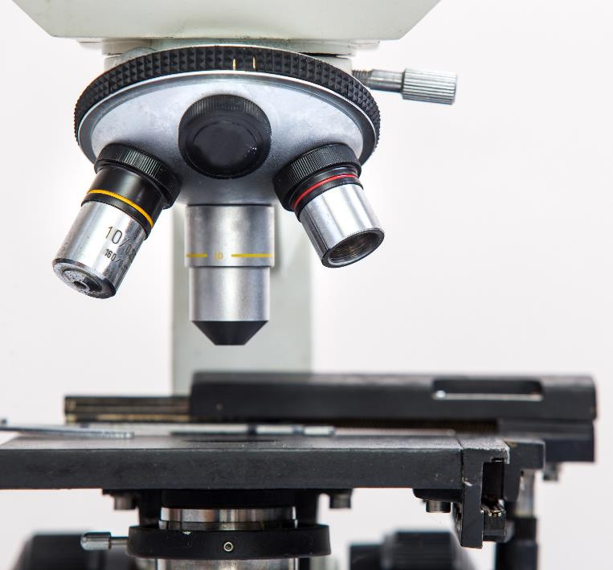
Objectives
Objective of this project is to classify the dataset for diabetes with highest accuracy possible.
This is proposed to be achieved through machine learning techniques.
Classification is a data mining part of our problem where we will use multiple algorithms and test their accuracy.

Slide 4

Dataset
The dataset is taken from the National Institute of Diabetes and Digestive and Kidney Diseases.
The objective is to predict based on diagnostic measurements whether a patient has diabetes.
In particular, all patients here are females at least 21 years old of Pima Indian heritage.
Features:
Pregnancies: Number of times pregnant
Glucose: Plasma glucose concentration a 2 hours in an oral glucose tolerance test
BloodPressure: Diastolic blood pressure (mm Hg)
SkinThickness: Triceps skin fold thickness (mm)
Insulin: 2-Hour serum insulin (mu U/ml)
BMI: Body mass index (weight in kg/(height in m)^2)
DiabetesPedigreeFunction: Diabetes pedigree function
Age: Age (years)
Outcome: Class variable (0 or 1)
Number of Instances: 768
Number of Attributes: 8 plus class

Slide 5


Libraries used
import pandas as pd
import numpy as np
import matplotlib.pyplot as plt
import seaborn as sns
from sklearn.model_selection import train_test_split
For Preprocessing:
from sklearn.preprocessing import StandardScaler
Machine Learning Algorithms
from sklearn.linear_model import LogisticRegression
from sklearn.ensemble import RandomForestClassifier
from sklearn.neighbors import KNeighborsClassifier
from sklearn.svm import SVC
To evaluate models
from sklearn.metrics import confusion_matrix
from sklearn.metrics import accuracy_score

Slide 6
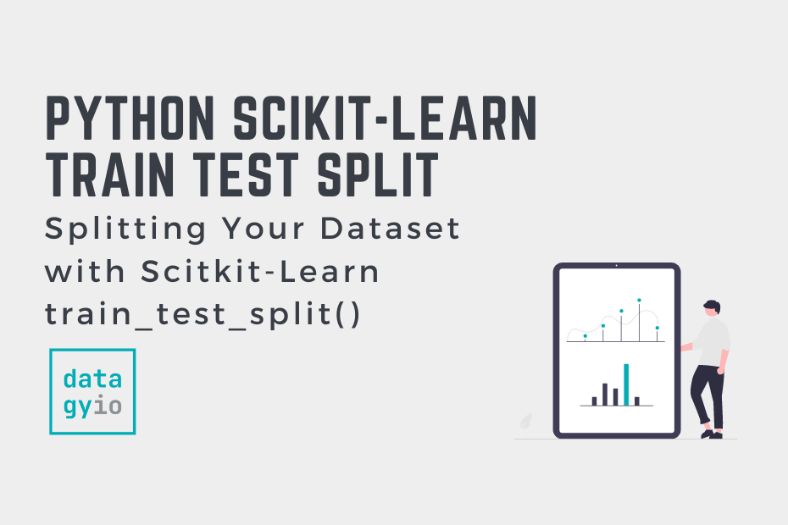
Dividing Train and Test data
We divide our dataset into training data and test data in the 80:20 ratio.
For this, we use train_test_split() function.
It is a function in Sklearn model selection for splitting data arrays into two subsets: for training data and for testing data. With this function, you don't need to divide the dataset manually.
By default, Sklearn train_test_split will make random partitions for the two subsets.
It can be imported from scikit-learn library.
from sklearn.model_selection import train_test_split

Slide 7
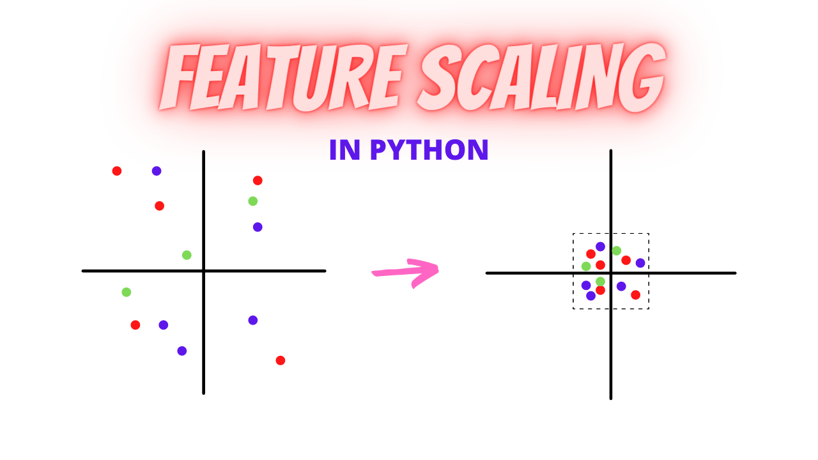
Feature Scaling
Feature scaling is a method used to normalize the range of independent variables or features of data.
In data processing, it is also known as data normalization and is generally performed during the data preprocessing step.
It is performed to handle highly varying magnitudes or values or units.
In this project, I have used StandardScaler.
StandardScaler standardizes a feature by subtracting the mean and
then scaling to unit variance. Unit variance means
dividing all the values by the standard deviation.
We can import StandardScaler() function from
Scikit-learn library in python.

Slide 8
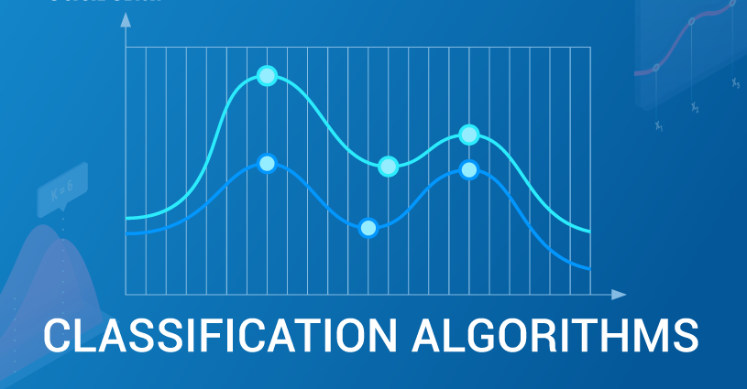
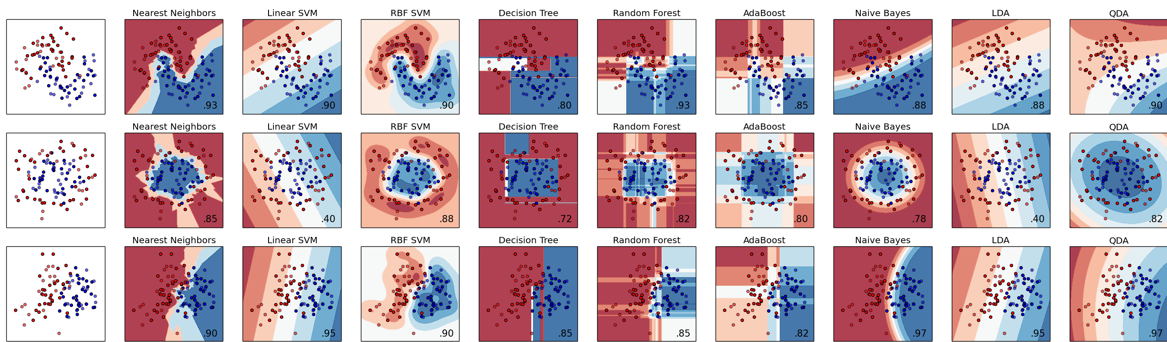
Classification Techniques
In this project, I have used four classification techniques for predicting if a person has diabetes or not.
They are as follows:
Logistic Regression
Random Forest
KNN ( k-nearest neighbors)
Support Vector Machine (SVC)
Class:
0: signals no diabetes
1: signals diabetes

Slide 9
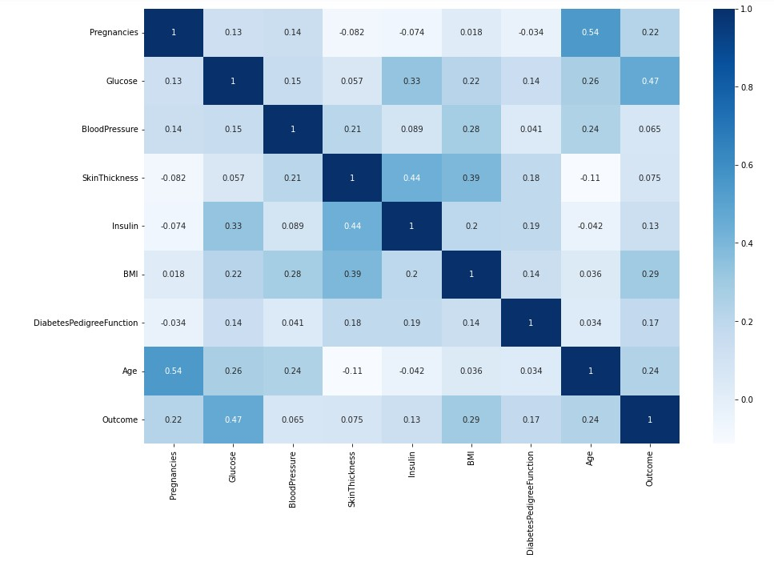
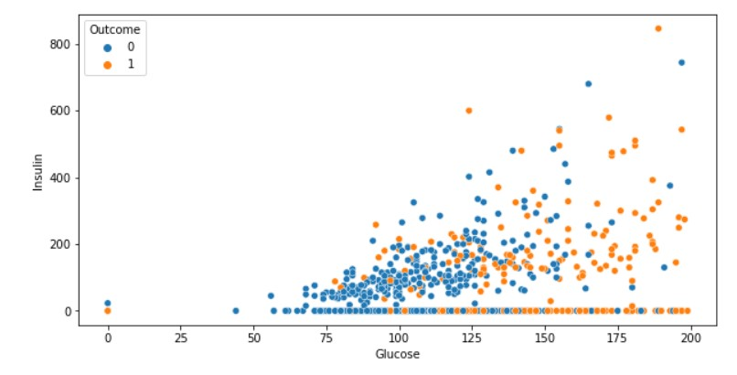
Charts, Graphs & Heatmaps
X-Y Graph between Glucose levels vs BMI
Heatmap of Correlation Data

Slide 10
Accuracy of models
Hence the accuracy of each model on test data is as follows:
Logistic Regression : 82.5%
Random Forest : 79.2%
KNN : 79.9%
SVC : 79.2%
Therefore we find that our Logistic Regressions Model serves the best for predicting diabetes in a patient.

Slide 11
Conclusion
After using all these patient records, we are able to build a machine learning model (Logistic Regression– best one) to accurately predict whether or not the patients in the dataset have diabetes or not along with that we were able to draw some insights from the data via data analysis and visualization.
These health records were organized in a structured way by eliminating noisy data. With the help of machine learning algorithms, knowledge is extracted from these records in the form of numerical values for the prediction of DR. Then four types of machine learning models were used to find out the results.
As a outcome of our experiments, The accuracy of Logistic Regression resulted as highest and is stable, reaching 82.5%.
Other models that were trained and tested were: Random Forest, KNN and Support Vector Machine (SVC).

Slide 12


Thank You
Rishabh Gupta
rishabh4459@gmail.com

